Slide 1



Owlmium
13/07/2022

Slide 2

Outline
Executive Summary
Introduction
Methodology
Results
Conclusion
Appendix

Slide 3
Executive Summary
Methodologies :
Data have been collected from two sources : the SpaceX API and the Wikipedia page of SpaceX.
The data have then been cleaned and correlation between the different parameters have been looked for. This process was performed with Python commands, SQL queries and the production of charts.
In order to reinforce the understanding of the dataset, an interactive dashboard was created displaying the relationship between multiple parameters.
Finally, a set of parameters was used to assess multiple models of classification (Logistic Regression, Support Vector Machine, Decision Tree and K Neighbors).
Results :
Data were efficiently was collected.
A large set of parameters was identified with having a possible correlation with the success rate of the landing of the rocket first stage.
When assessed, all classification models resulted in the same accuracy of 0,83.
Thus, Machine learning seems to be an interesting method for the prediction of the landing of the first stage of a given rocket.

Slide 4
Introduction
In this report, we will predict if the Falcon 9 first stage will land successfully. SpaceX advertises Falcon 9 rocket launches on its website, with a cost of 62 million dollars; other providers cost upward of 165 million dollars each, much of the savings is because SpaceX can reuse the first stage.
Therefore, if we can determine if the first stage will land, we can determine the cost of a launch. This information will be used for the company SpaceY in order to build competitive rockets thanks to Machine Learning.
However, before finding a suitable model, multiple problem should be assessed :
How to obtain a sufficient amount data
Clean the dataset to it is easy to work with
Identify the data from the dataset that are relevant to our problematic
Identify the best performing model for our problematic
Assess the accuracy of this model

Slide 5

Section 1

Slide 6
Methodology
Executive Summary
Data collection methodology:
Describe how data was collected
Perform data wrangling
Describe how data was processed
Perform exploratory data analysis (EDA) using visualization and SQL
Perform interactive visual analytics using Folium and Plotly Dash
Perform predictive analysis using classification models
How to build, tune, evaluate classification models

Slide 7
Data Collection
Data on SpaceX were collected using two methods :
First data were first collected using the SpaceX API with Request (see Data Collection – SpaceX API).
Then data were the collected using web scrapping from the SpaceX Wikipedia page (see Data Collection - Scraping)

Slide 8
Data Collection – SpaceX API
1
2
3
4
5
Data are obtained from the API
The response (JSON) is turned into a DataFrame
As the DataFrame contains IDs, the API is called again to get information using the IDs in lists
A dictionary containing all the obtained lists is created
The dictionary is converted to a DataFrame
Obtain data with Requests.GET()
Convert Response to a DataFrame
(pd.json_normalize())
Fill information with calls to the API
response = requests.get(“url"+str(x)).json()
data.append(response[‘data']
Put data in a dictionary
Dict = {‘key’:[list]…}
Convert Dict to DataFrame
df = pd.DataFrame(dict)

Slide 9
Data Collection – SpaceX API
The code can be found using the following GitHub link :
https://github.com/Owlmium/Capstone_project/blob/efc854a75deda730961766637fcdd4a3e3106322/Data_Colection_API_Git.ipynb

Slide 10
Data Collection - Scraping
1
2
3
4
5
Obtain data with Requests.GET()
response = requests.get(url)
Obtain data from the web page
Create a BeautifulSoup Object with HTML
Locate all the tables of the page
Loop through the tables to get the headers of our DataFrame
Fill the DataFrame by findind the data contained in the tables
Create a BeautifulSoup Object with HTML
soup = BeautifulSoup(response.text, 'html.parser')
Locate all the table with ‘tr’
soup.find_all('tr')
Loop through tables to get header
extract_column_from_header(row)
Pass the tables data in a DataFrame
Find_all(…
'table',"wikitable plainrowheaders collapsible")
“tr"
'td'

Slide 11
Data Collection - Scraping
The code can be found using the following GitHub link :
https://github.com/Owlmium/Capstone_project/blob/48dcaf798aef3c5afbc5ecbc343c93ee21c50b47/Web_Scrapping_Git.ipynb

Slide 12
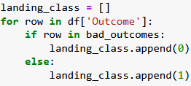
Data Wrangling
In order to find patterns in the data and determine what would be the label for training supervised model, exploratory data analysis were performed
1
2
3
Understand the data (null values, type…)
Estimate the repartition of the data:
Number of launches on each site
Number and occurrence of each orbit
Number and occurrence of mission outcome per orbit type
Finaly the success rate is determined by creating a landing outcome label from Outcome column
1.
2.
3.

Slide 13
Data Wrangling
The code can be found using the following GitHub link :
https://github.com/Owlmium/Capstone_project/blob/eb00e934cda8079daef6e7fa305c98ab21f5f51f/Data_Wrangling_Git.ipynb

Slide 14
EDA with Data Visualization
Summarize what charts were plotted and why you used those charts
Add the GitHub URL of your completed EDA with data visualization notebook, as an external reference and peer-review purpose

Slide 15
EDA with Data Visualization
Exploratory data analysis were performed as well using graphical representations.
First, the dependance between launch site, class (success or failure) and flight number have been studied in a scatter plot.
Then, the existence of a relationship between payload mass and launch site with the class has also been observed in a scatter plot.
As several orbits can be considered for the launch, the success rate depending on the orbit type was visualized as a bar chart.
The orbit and class depending on the flight number have also been observed, this time in a scatter plot.
Similarly, the orbit and class depending on the payload mass have also been observed.
Finally, the success rate depending on the launch year was studied in a line plot.

Slide 16
EDA with Data Visualization
The code can be found using the following GitHub link :
https://github.com/Owlmium/Capstone_project/blob/5396def6ed4ce6b214c1ad6c3e79b072cc252ff4/eda-dataviz_Git.ipynb

Slide 17
EDA with SQL
First the unique launch sites in the space mission were displayed.
More in details, 5 records where launch sites begin with the string 'KSC’ were displayed.
Then, the total payload mass carried by boosters launched by NASA (CRS) was displayed.
The average payload mass carried by booster version F9 V1.1 was displayed.
The date where the first successful landing outcome in drone ship was achieved was displayed.
The names of the boosters which have success in ground pad and have payload mass greater than 4000 but less than 6000 was listed.
The total number of successful and failure mission outcomes was listed.

Slide 18
EDA with SQL
The names of the booster versions which have carried the maximum payload mass were listed.
The records which will display the month names, successful landing outcomes in ground pad ,booster versions, launch site for the months in year 2017 were listed.
Finally, the count of successful landing outcomes between the date 2010-06-04 and 2017-03-20 were ranked in descending order.
The code can be found on GitHub following this link * :
https://github.com/Owlmium/Capstone_project/blob/c4a1551598149e85798d55fe640e232c355a51e2/EDA_with_SQL_Git.ipynb
* Running the code as is will not work as identification information have been removed.

Slide 19
Build an Interactive Map with Folium
A map of the launch sites was created with Folium.
First, the launch sites have been added to the map as cycles to easily localize them.
Lines have been added to represent the distance from the equator.
Then, successful and failed launches have been represented with markers on the map. As multiple launches have similar coordinates, the markers have been placed in clusters.
Finally, In order to understand better the location of the launch sites, their distance regarding different items (rails, highways, coastline, cities) have been studied first on a map and then in a table
The code can be found on GitHub following this link :
https://github.com/Owlmium/Capstone_project/blob/04dcba9d103758d6c8cf7d08f56feb3b1da08f4a/launch_site_location_Git.ipynb

Slide 20
Build a Dashboard with Plotly Dash
A dashboard have been built in order to better observe the link between the launch site, booster version and success rate.
First a dropdown list have been added to the dashboard so the user can select the launch site he is interested in. An option ‘All Sites’ have as well been added to select all data.
A pie chart have been created displaying the success rate of the launching site if all sites have been selected. If a specific site was selected in the dropdown list, the success versus failure rate was displayed in the pie chart.
Then, a slider was added to allow the user to select a payload range between 0 and 10000 Kg.
Finally, a scatter plot was added displaying the class depending on the payload mass for the site previously selected in the dropdown list. The data are displayed with different colors depending on the booster version category.

Slide 21
Build a Dashboard with Plotly Dash
A complete screenshot of the dashboard can be seen in appendix 4.1
The code used for the callback function can be seen in appendix 4.2
The code can be found on GitHub following this link :
https://github.com/Owlmium/Capstone_project/blob/faf983a8552731c6b8cc28c328efdb934a69bc74/Dash_Git.ipynb

Slide 22
Predictive Analysis (Classification)
Finally, a model was built to best estimate the success rate. In order to find the best models, multiple models were essayed :
Logistic Regression
Support Vector Machine
Decision Tree
K Neighbors
First the independent data (X) were standardized.
Then the independent and dependent data (X and Y) were split into two dataset : the train and test set.
The models were fitted on the train set with searching for the best parameters thanks to the Grid Search Cross Validation.
Finally, the accuracy of the model was evaluated on the test set and a confusion matrix was built

Slide 23
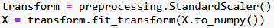
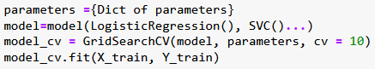
Predictive Analysis (Classification)
Process for finding the best classification model
Standardization
Train and Test Set Split
Best Parameters On Train Set
Accuracy On Test set

Slide 24
Predictive Analysis (Classification)
The code can be found on GitHub following this link :
https://github.com/Owlmium/Capstone_project/blob/955488ded7fc29189896d7191a0fec99c4884401/SpaceX_Machine%20Learning%20Prediction_Git.ipynb

Slide 25
Results
Exploratory data analysis allowed to identify that multiple parameters as the flight number, launch site, payload mass, orbit considered, booster version or year of launch could be correlated to the success of the first stage landing (class). Thus, a set of parameters was selected in order to build a predictive model.
In order to better visualize the correlation between these parameters, an interactive dashboard was built (see appendix 4.1).
Finally, after assessing different classifier models, it was observed that all models results in a similar accuracy. A good accuracy up to 0,83 could be obtained.
Thus, Machine Learning can be applied to the data coming from SpaceX to predict with a good accuracy the result of the first stage landing of a given rocket.

Slide 26

Section 2

Slide 27
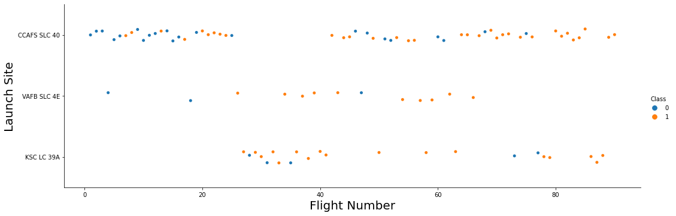
Flight Number vs. Launch Site
It can be observed that the launch site CCAFS SLC 40 was employed for the first flights followed by VAFB SLC 4E and KSC LC 39A. This could explain the lower success rate of CCAFS SLC 40 as flights with low flight numbers have a lower chance to succeed in the landing of the first stage as shown previously.
Launch site and Class depending on the flight number

Slide 28
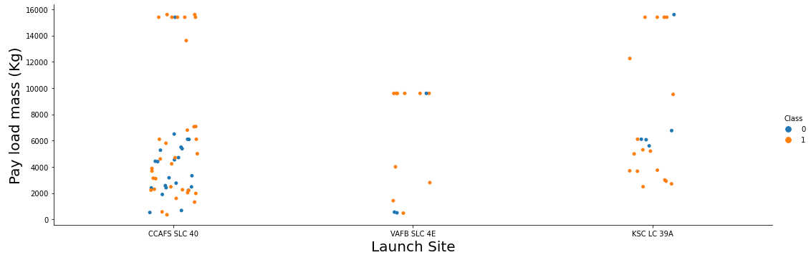
Payload vs. Launch Site
Payload mass and Class depending on the launch site
VAFB SLC 4E seems to have been used only for low payload mass. CCAFS SLC 40 have in majority been used for low payload mass with few extreme exceptions. Finally, KSC LC 39A was employed for medium to high payload mass. This could be in favor of the good results of the launch site VAFB SLC 4E

Slide 29
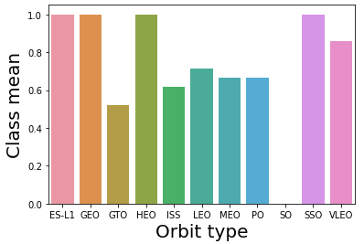
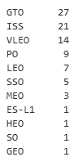
Success Rate vs. Orbit Type
The higher success rates (100%) are obtained for the orbit ES-L1, GEO, HEO and SSO.
They are followed by VLEO, LEO, MEO, PO and GTO.
SO present the lower success rate with 0%.
However, it is important to denote that all orbits are not represent by the same number of samples. Moreover, several orbit are only represented by one sample, making the data less significant.
Orbit | Count
GTO | 27
ISS | 21
VLEO | 14
PO | 9
LEO | 7
SSO | 5
MEO | 3
ES-L1 | 1
HEO | 1
SO | 1
GEO | 1

Slide 30
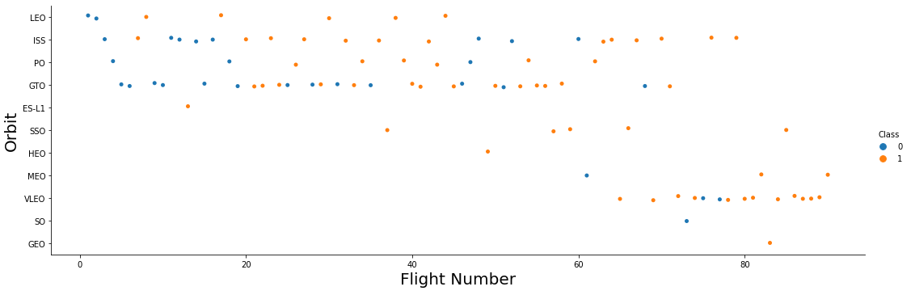
Flight Number vs. Orbit Type
Orbit and class depending on the flight number
It appears that for the orbit LEO, the success (Class) seems highly related to the flight number (with lower success for lower flight number. For other orbits as GTO or ISS, nor direct relationship can be observed

Slide 31
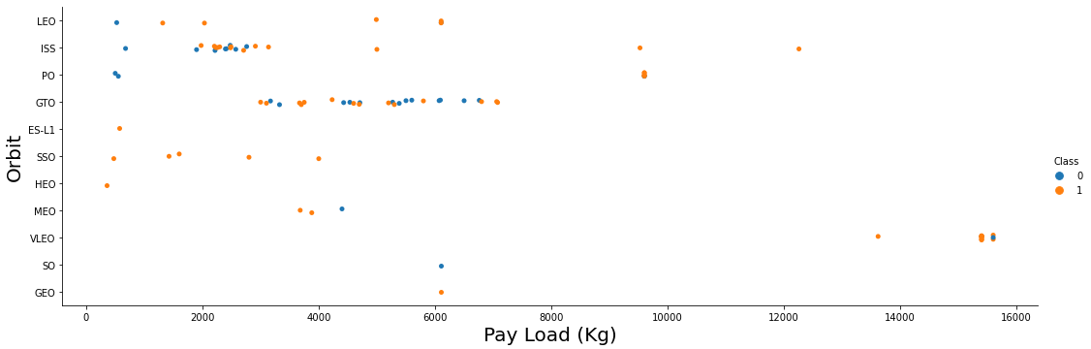
Payload vs. Orbit Type
Orbit and class depending on the payload mass
It appears that for the orbit LEO, PO and ISS the success (Class) seems highly related to the payload (with higher success rate for high payload. However, for other orbits as GTO, nor direct relationship can be observed

Slide 32
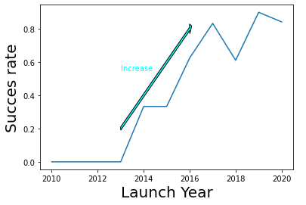
Launch Success Yearly Trend
It can clearly be observed that the success rate increase starting 2013 with launch year, attesting of the increase in competences of SpaceX along time. This increase is less pronounced from 2017.
Success rate depending on the launch date

Slide 33
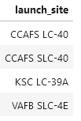
All Launch Site Names
First the unique launch sites in the space mission were displayed.
For that, a query using ‘Distinct’ on ‘Launch_Site’ was used.

Slide 34
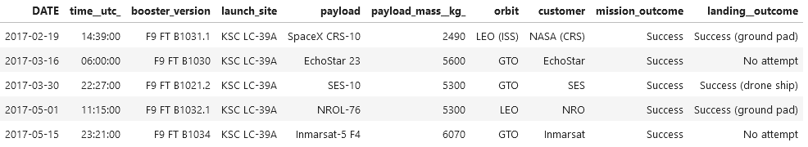
Launch Site Names Begin with 'KSC'
More in details, 5 records where launch sites begin with the string 'KSC’ were displayed.
This time a query asking for the records where Launch_Site contain ‘KSC’ have been employed with % precising that the character could be contained in the name.
The result were limited to 5 records.

Slide 35
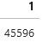
Total Payload Mass
Then, the total payload mass carried by boosters launched by NASA (CRS) was displayed.
The query sums the value of payload mass for the records that has ‘NASA (CRS)’ as customer.

Slide 36
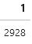
Average Payload Mass by F9 v1.1
The average payload mass carried by booster version F9 V1.1 was displayed as following.
This time the query calculate the average of the value of payload mass for the records that has ‘F9 v1.1’ as booster_version.

Slide 37

First Successful Ground Landing Date
The date where the first successful landing outcome in drone ship was achieved was displayed.
The query allowed to search for the minimum date resulting in the earlier date.

Slide 38
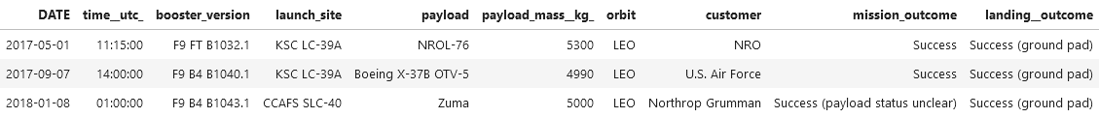
Successful Drone Ship Landing with Payload between 4000 and 6000
The names of the boosters which have success in ground pad and have payload mass greater than 4000 but less than 6000 was listed as follow.
The use of AND allows to apply multiple conditions to the query.

Slide 39
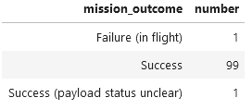
Total Number of Successful and Failure Mission Outcomes
The total number of successful and failure mission outcomes was listed.
Two information were displayed : the different values of mission outcome and the count of outcomes. This is made possible by the ‘GROUP BY’.

Slide 40
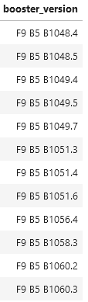
Boosters Carried Maximum Payload
The names of the booster versions which have carried the maximum payload mass were listed.
As previously, ‘Distinct’ allowed to display the different unique booster_version with the condition that the payload mass correspond to the maximum value

Slide 41
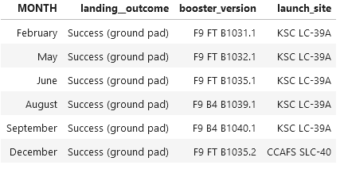
2015 Launch Records
The records which will display the month names, successful landing outcomes in ground pad ,booster versions, launch site for the months in year 2017 were listed.
‘MONTHNAME’ allow to obtain the month name.
‘YEAR’ allow to search records with a date contained in the year 2017.

Slide 42
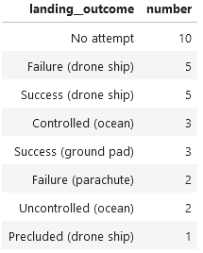
Rank Landing Outcomes Between 2010-06-04 and 2017-03-20
Finally, the count of successful landing outcomes between the date 2010-06-04 and 2017-03-20 were ranked in descending order.
The query contain ‘BETWEEN’ which allow to search between two dates.

Slide 43

Section 3

Slide 44
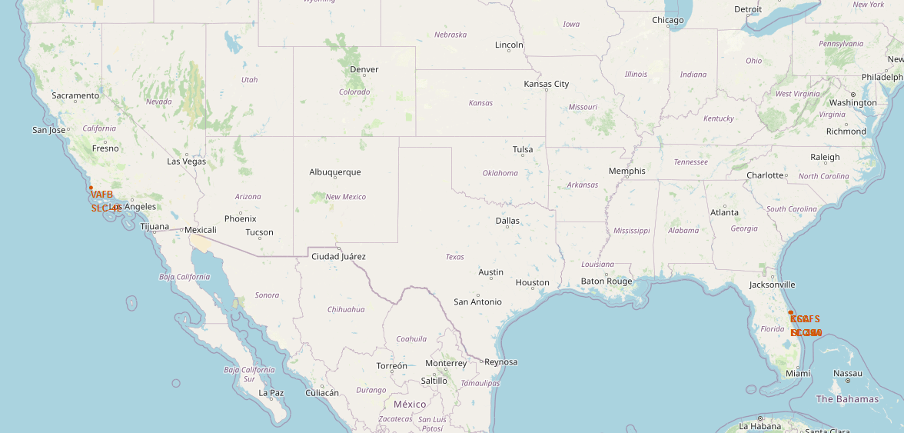
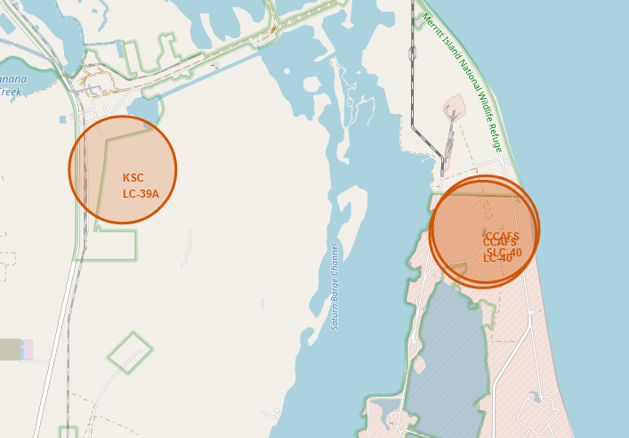
Map of SpaceX Launch Sites
All the launch sites are situated in the USA.

Slide 45
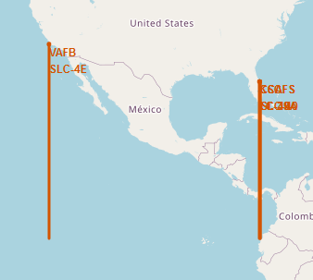
Distance of Launch Sites from the Equator
It appears clearly that the launch sites are placed at the nearest point to the equator while still remaining in the USA.
This is logical as rocket launch requires proximity to the equator to allow optimal conditions.
See code in Appendix 3.1

Slide 46
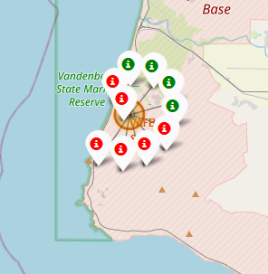
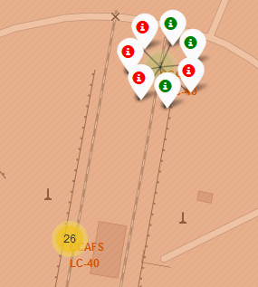
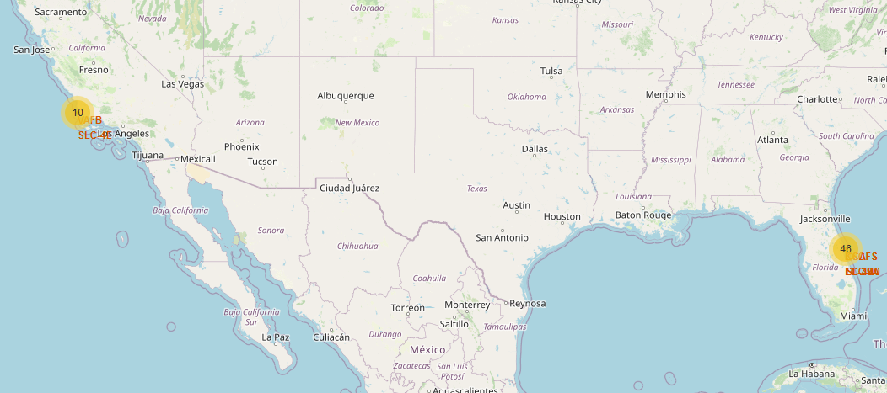
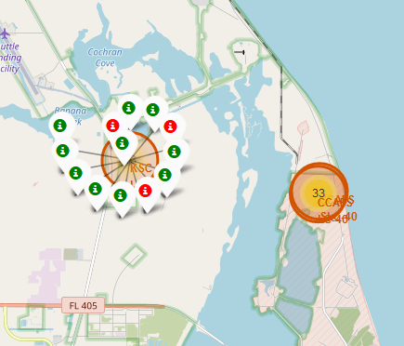
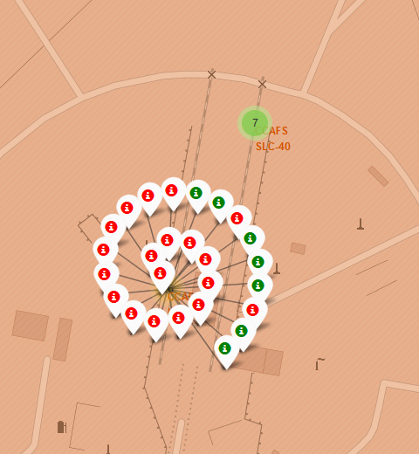
Successful and unsuccessful launches displayed on a map
This highlight the good results of the launch site KSC LC-39A.
However, these good results seems not linked to localization as its neighbor the launch site CCAFS LC-40 shows a poorer success rate.
CCAFS SLC-40
VAFB SLC-4E
KSC LC-39A
CCAFS LC-40

Slide 47
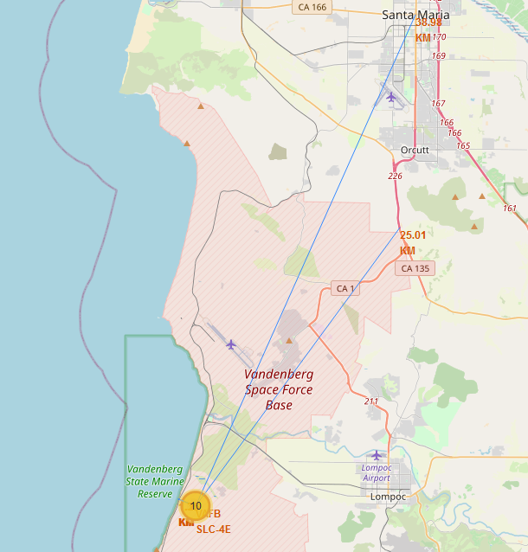
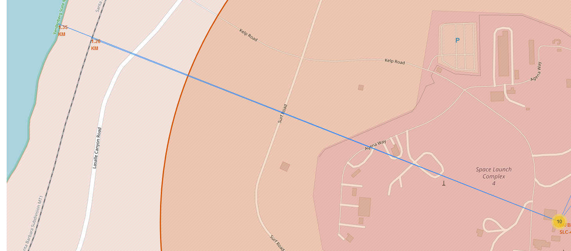
Distance of Launch Sites from Various Objects
A line representing the distance as well as a marker displaying the numerical value have been added. As an example, the distances with the VAFB SLC-4E are represented

Slide 48
Build an Interactive Map with Folium
When the distances are displayed in a table, several observation can be done.
Launch Sites are situated near railways : This way, rocket parts can easily be carried in place.
Launch Sites are situated near coastlines : This guaranty a low populated area in case of incident and ease the recovery of ejected rocket parts.
Launch Sites are situated away from major cities and highway : In case of rocket failure, this avoid derbies to fall on highly populated areas or of highway causing traffic perturbations.
 | Distance from (Km)
Launch Site | Railways | Coastline | Major City | Highway
CCAFS LC-40 | 1.3 | 0.9 | 79.0 | 26.8
CCAFS SLC-40 | 1.3 | 0.8 | 79.0 | 26.9
KSC LC-39A | 6.0 | 7.7 | 72.2 | 20.0
VAFB SLC-4E | 1.3 | 1.4 | 39.0 | 25.0
See code in Appendix 3.2

Slide 49

Section 4

Slide 50
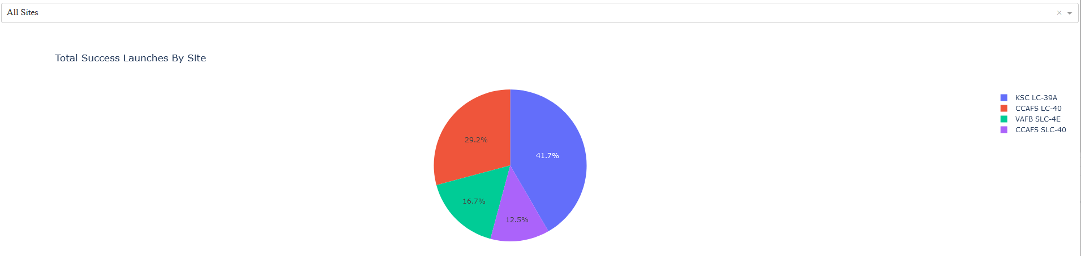
Total Launch Success Rate for all Sites
Success rate of the different launch sites represented in a pie chart
It can be observed that the launch site KSC LC-39A shows the higher total of success
Thus, this confirms the previous results obtained in the previous sections

Slide 51
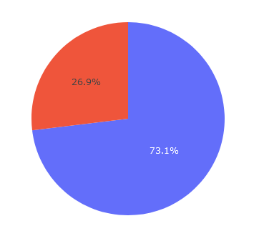
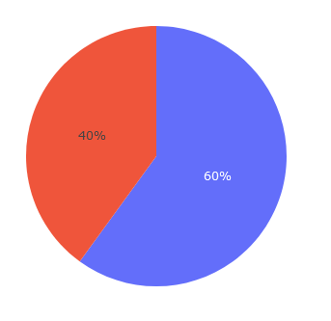
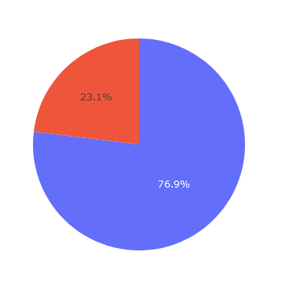
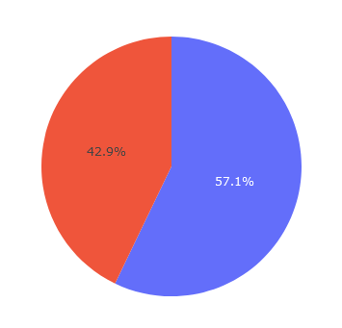
Launch Success Rate Sites by Site
Success rate for different launch sites represented in a pie chart
CCAFS LC-40
VAFB SLC-4E
KSC LC-39A
CAFS SLC-40
It can be observed that the higher success rate is obtained for the KSC LC-39A
Again, this confirms the previous results obtained in the previous sections

Slide 52
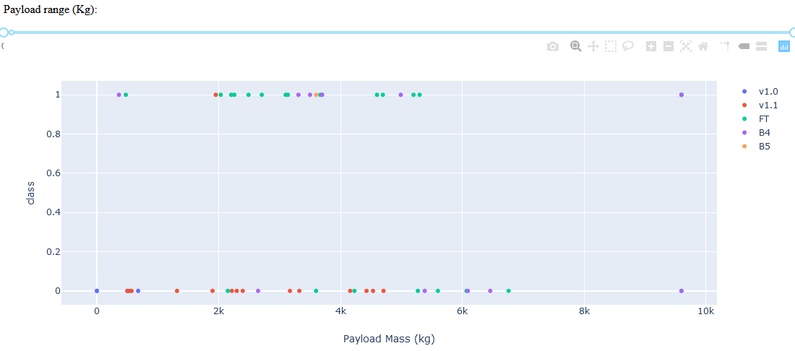
Payload vs. Launch Outcome scatter plot (1/3)
Payload vs. Launch Outcome scatter plot on the whole payload mass range
On the whole range, the booster FT seems to have a high success rate while the booster v1.1 shows an important number of failure.

Slide 53
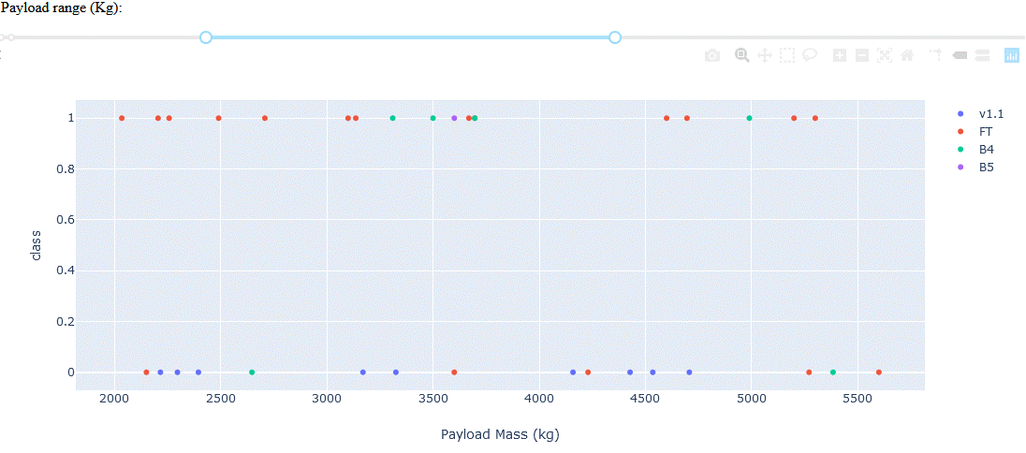
Payload vs. Launch Outcome scatter plot (2/3)
Payload vs. Launch Outcome scatter plot for a payload mass in the range 2000 – 6000 Kg
The larger amount of success can be observed for a payload between 2000 and 6000 Kg and can be attributed to the boosters FT, B4 and F5.

Slide 54
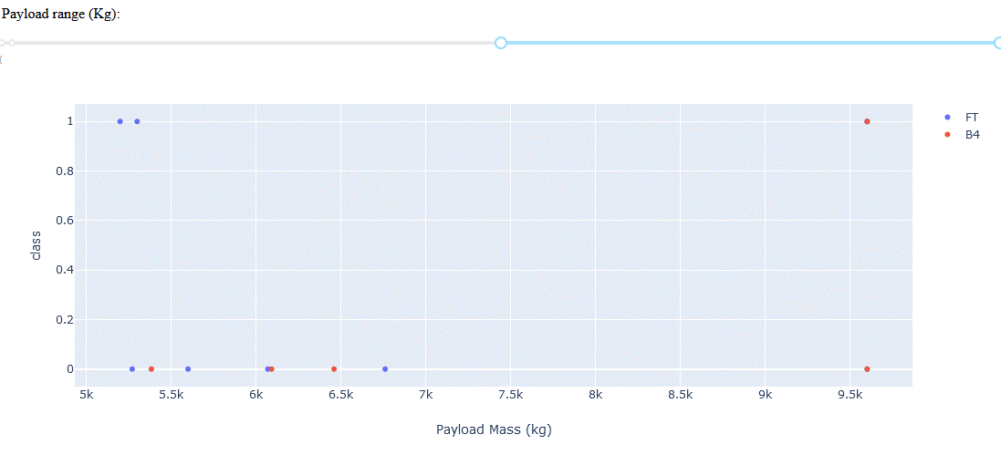
Payload vs. Launch Outcome scatter plot (3/3)
Payload vs. Launch Outcome scatter plot for a payload mass above 6000 Kg
It is interesting to note that for a payload mass superior to 6000 Kg only the boosters FT and B4 have been employed but this time with an extremely low success rate.
Thus, a high payload mass seems to be a disadvantage.

Slide 55

Section 5

Slide 56
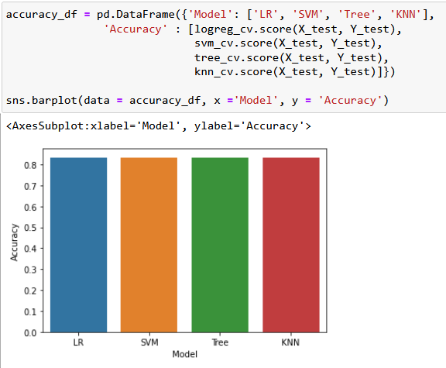
Classification Accuracy
The model with the highest accuracy was searched. Thus, the accuracy of each models was placed in a bar chart.
It appears that all models present a similar accuracy.

Slide 57
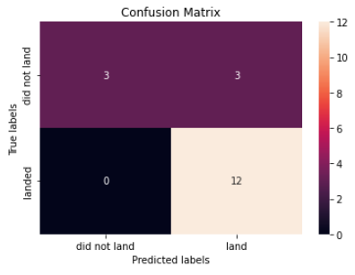
Confusion Matrix
As all models performed equally, a similar confusion matrix was obtained ass follow :
In General, the confusion matrix shows a good predictability.
It can be noted that false positive can be obtained. However, it is safer to consider falsely that the stage landing will fail that the opposite.
True Positive
False Positive
False Negative
True Negative

Slide 58
Conclusions
Data can be efficiently extracted from SpaceX API OR the SpaceX Wikiepedia page.
Exploratory data analysis allowed to identify that multiple parameters as the flight number, launch site, payload mass, orbit considered, booster version or year of launch could be correlated to the success of the first stage landing (class). Thus, a set of parameters was selected in order to build a predictive model.
An interactive dashboard especially allowed to exacerbate this observation.

Slide 59
Appendix

Slide 60
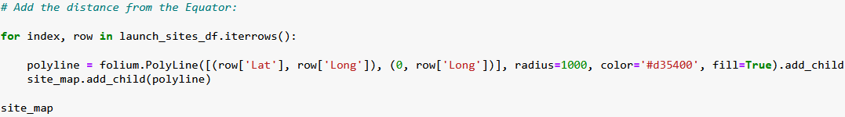
Appendix
Appendix 3.1 : Adding the distance to the equator

Slide 61
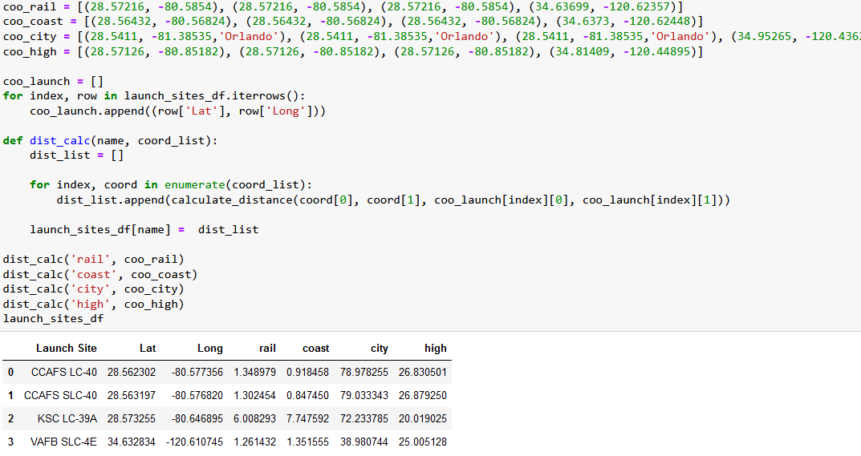
Appendix
Appendix 3.2 : Calculating distance from launch site

Slide 62
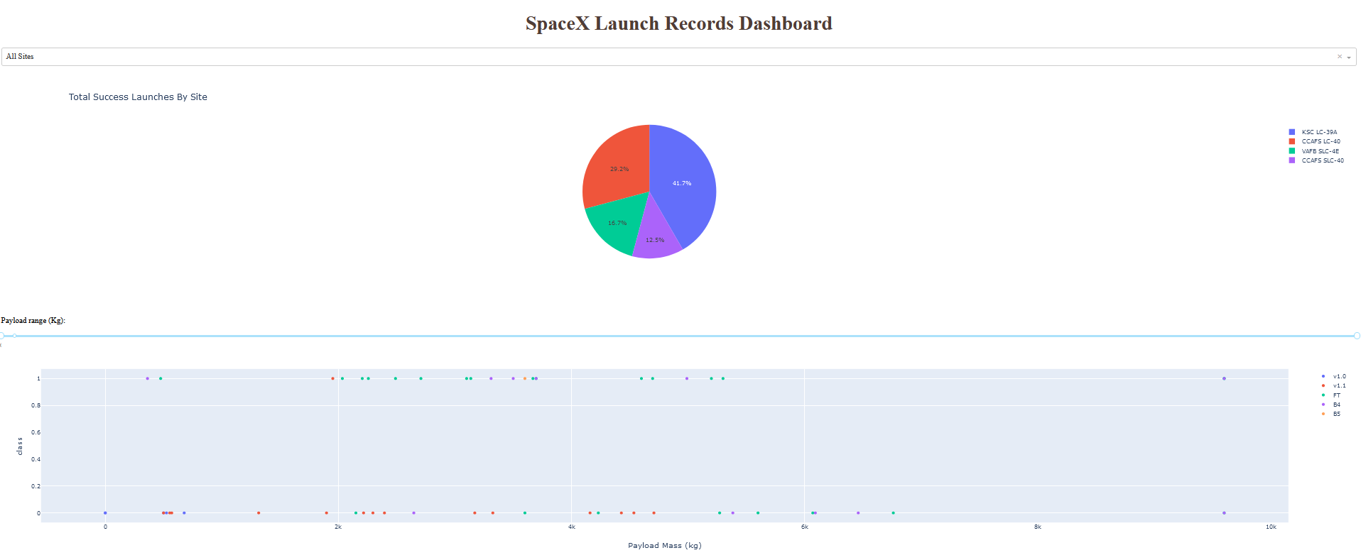
Appendix
Appendix 4.1 : Full screenshot of the SpaceX Launch Records Dashboard

Slide 63
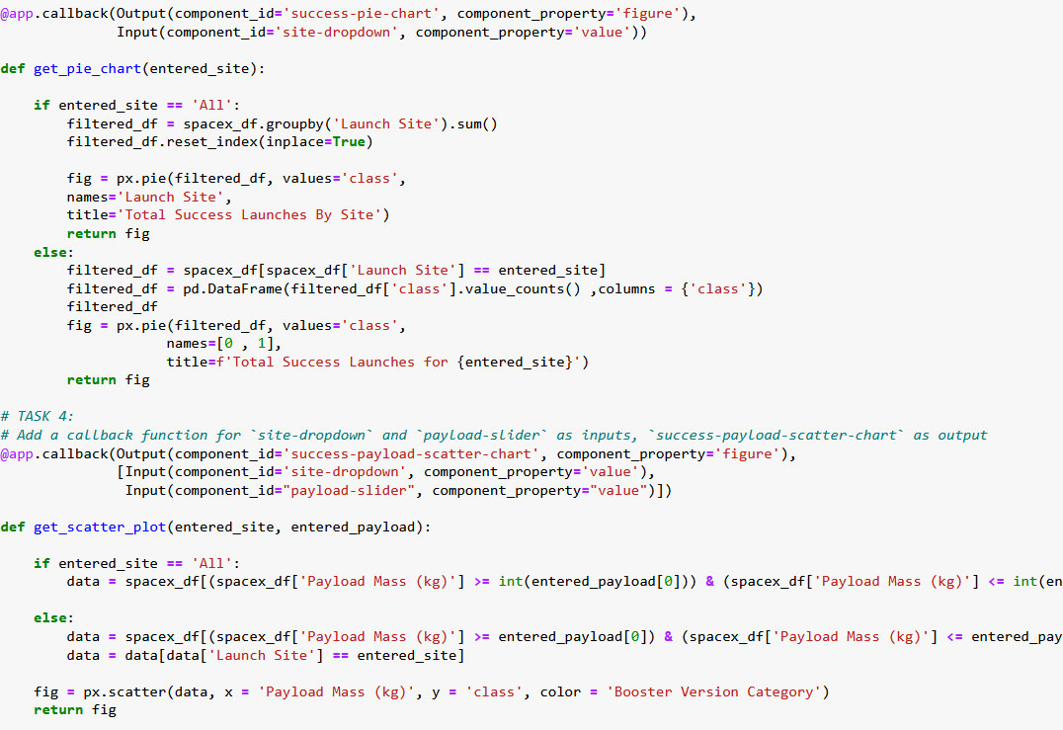
Appendix
Appendix 4.2 : Callback functions

Slide 64


